Slide 1
Security Analysis and Improvements on WLANs
Li Wang, Bala Srinivasan, Nandita Bhattacharjee
Clayton School of IT, Melbourne, Australia
Giuseppe Miraglia
University of Pisa
15/07/2015

Slide 2


IEEE 802.11 WLANs overview
WLAN: Wireless Local Area Network
IEEE or "I triple E", Institute of Electrical and Electronics Engineers: association of professionals in Electronics, Computer Engineering, Computer Science, etc.
IEEE 802.11: set of standards for WLANs created and mantained by IEEE (e.g. 802.11 b/a/g/n/ac etc., different Ghz & Mbps ranges)
Wi-Fi: “any WLAN product based on IEEE 802.11 standards”, often used as synonym for WLAN (majority of modern WLANs are based on these standards)
IEEE 802.11i: standard for security specifications of IEEE 802.11 series WLANs, replacement of old WEP (Wired Equivalent Privacy) standard

Slide 3
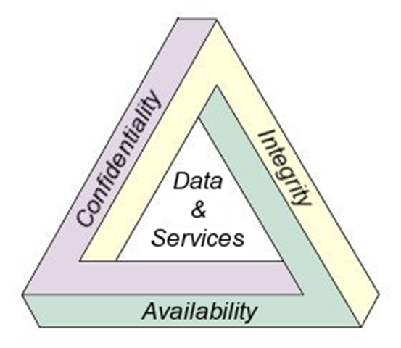
IEEE 802.11i security standard
known as WPA2 (Wi-Fi Protected Access 2)
aims to eliminate all known attacks against WEP …
… but provides solutions only to Confidentiality and Integrity, but not to some Availability aspects (e.g. DoS - Denial of Service attacks)
WPA before proposed as intermediate protocol between WEP and WPA2: less expensive, but less secure than WPA2
"CIA" Triad
Paper’s goal: propose solutions to improve security of IEEE 802.11i preventing attacks to it

Slide 4


IEEE 802.11i security steps (1/5)
AP₂
Network Discovery
---
---
---
---
Beacon Frames
C₁
C₂
APs broadcast beacon frames to announce their presence
Cs scan beacon frames to update their own list of reachable APs
AP₁
C₄
C₃
Probe Requests
C₁
AP₁
Cs broadcast probe requests in order to find APs
APs answer with probe response
AP₂
C₂
AP₃
Notes:
beacon == faro
probe == indagine

Slide 5
IEEE 802.11i security steps (1/5) – security
Network Discovery
---
---
---
---
Existing vulnerabilities:
both beacon frames and probe requests are sent in clear text ➔ passive (listen but not alter) or active (listen and alter) eavesdropping attacks can be mounted
e.g. using active eavesdropping, a MiM can answer to probe requests and induce C to connect to him ➔ information stealing
IEEE 802.11w standard for management frames resolves these issues, otherwise no improvements w.r.t. WEP
Notes:
Eavesdropping == intercettazione

Slide 6
IEEE 802.11i security steps (2/5)
Network Discovery
IEEE 802.11 Authentication & Association
---
---
---
Two possible approaches in 802.11i:
PSK (Pre-Shared Key)
firstly developed for WEP, maintained for backward compatibility
widely used in home/small offices/ad-hoc WLANs: simple, economic and easy configurable
known as WPA-PSK or WPA-Personal
susceptible to offline-dictionary and internal attacks (see after 4-way handshake)
Open System
"rough" link-layer authentication and association, no data encryption used ➔ existing vulnerabilities as in step 1
usually combined with 802.1x upper-layer authentication (next step) ➔ in that case known as WPA-Enterprise

Slide 7
IEEE 802.11i security steps (2/5) – cont.
Network Discovery
IEEE 802.11 Authentication & Association
---
---
---
PSK-based authentication
C
AP
Authentication Request
Generate
challenge
Encrypt
challenge
using PSK
Authentication Response
(with plain-text challenge)
Authentication Response
(with PSK-encrypted challenge)
Verify
challenge
using PSK
Authentication Response
(SUCCESS / FAILURE)

Slide 8
IEEE 802.11i security steps (2/5) – cont.
Network Discovery
IEEE 802.11 Authentication & Association
---
---
---
Open System Authentication
A client C chooses an access point AP and starts the link-layer authentication process
(C status = "not authenticated, not associated")
link-layer 802.11 authentication request frame
(MAC_{C} + MAC_{AP}+ request + etc.)
C
AP
link-layer 802.11 authentication response frame
(MAC_{AP}+ MAC_{C} + SUCCESS / FAILURE + etc.)

Slide 9
IEEE 802.11i security steps (2/5) – cont.
Open System Association
Network Discovery
IEEE 802.11 Authentication & Association
---
---
---
If the answer is SUCCESS, then C starts the link-layer association process with AP (C status = "authenticated, not yet associated")
link-layer 802.11 association request frame
(MAC_{C} + MAC_{AP}+ request + etc.)
C
AP
link-layer 802.11 association response frame
(MAC_{AP}+ MAC_{C} + SUCCESS / FAILURE + etc.)
If the answer is SUCCESS, then C is authenticated and associated to AP (C status = "authenticated, associated")

Slide 10
IEEE 802.1x – based upper-layer authentication
IEEE 802.11i security steps (3/5)
Network Discovery
IEEE 802.11 Authentication & Association
IEEE 802.1x Authentication
---
---
when combined with Open System, known as WPA-Enterprise (skipped in WPA-Personal)
strong security and mutual authentication w.r.t. PSK-mode, but more expensive
requires an AP and a RADIUS Authentication Server (AS)
RADIUS (Remote Authentication Dial-In User Service): AAA (Authentication-Authorization-Accounting) protocol today standard de-facto for remote authentication
All C, AP and AS must support EAPOL (EAP Over LAN) incapsulation
EAP (Extensible Authentication Protocol): it does not defines itself an authentication protocol, instead it provides methods to negotiate "On the fly" the authentication method to use during the session (i.e. EAP-MD5, EAP-TLS, EAP-AKA, LEAP, PEAP, etc.)

Slide 11



IEEE 802.11i security steps (3/5) - cont
C
AP
AS
Network Discovery
IEEE 802.11 Authentication & Association
IEEE 802.1x Authentication
---
---
Enterprise
Network
EAPOL Start auth.
EAP request UserID
Authentication Method Handshake
(es. EAP-TLS)
EAP answer UserID
RADIUS access request for UserID
AS-side EAP-TLS
C-side EAP-TLS
MSK
MSK
RADIUS answer "SUCCESS" (with MSK)
PMK
PMK
Move PMK
PMK
EAP Success
PMK = PSK in
PSK-based authentication

Slide 12
IEEE 802.11i security steps (3/5) – security
Network Discovery
IEEE 802.11 Authentication & Association
IEEE 802.1x Authentication
---
---
PMK (Pairwise Master Key) derived from MSK (Master Session Key) and "fresh" (current session)
MSK exchanged with security during EAP-TLS session
EAP-TLS use a TLS (Transport Layer Security) session within EAP providing strong security:
provides mutual authentication
both C and AS own a certificate, so a PKI (Public Key Infrastructure) for validation is needed ➔ more expensive
As alternative use EAP-MD5, but:
only client-side authentication ➔ possible MiM attacks to impersonate AP or AS ➔ steal sensitive C’s data
hash MD5-based ➔ susceptible to offline-dictionary attacks
cheap w.r.t. EAP-TLS, but less secure

Slide 13
4-Way Handshake
IEEE 802.11i security steps (4/5)
Network Discovery
IEEE 802.11 Authentication & Association
IEEE 802.1x Authentication
4-Way/Group Key Handshake
---
C
AP
PMK
PMK
Compute
Nonce_{AP}
Compute
Nonce_{C}
& PTK,
store PTK
Msg1 = { MAC_{AP} + Nonce_{AP} + SN }
Msg2 = { MAC_{c} + Nonce_{c} + SN + MIC_{PTK}(Nonce_{c} , SN) }
Compute
& store PTK,
verify MIC
Verify MIC
&
Install PTK
Msg3 = { MAC_{AP} + Nonce_{AP} + SN+1 + MIC_{PTK}(Nonce_{AP} , SN+1) }
("Ready to use" )
Verify MIC
&
Install PTK
Msg4 = { MAC_{AP} + Nonce_{AP} + SN+1 + MIC_{PTK}(Nonce_{AP} , SN+1) }
("OK, use" )

Slide 14
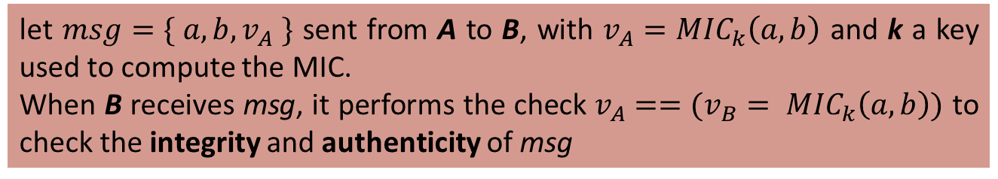
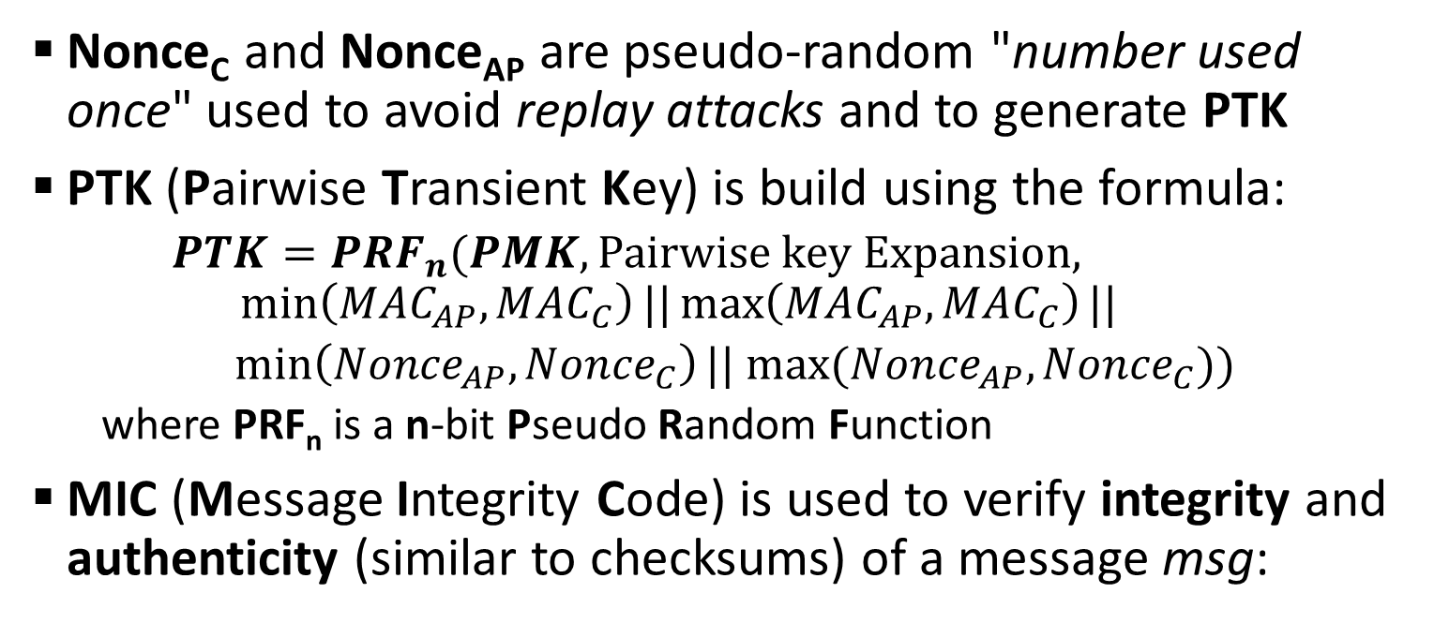
IEEE 802.11i security steps (4/5) – cont.
Network Discovery
IEEE 802.11 Authentication & Association
IEEE 802.1x Authentication
4-Way/Group Key Handshake
---
Nonce_{C} and Nonce_{AP} are pseudo-random "number used once" used to avoid replay attacks and to generate PTK
PTK (Pairwise Transient Key) is build using the formula:
$PTK={PRF}_{n}(PMK,\text{Pairwise} \text{key} \text{Expansion},$
$$\min\left({MAC}_{AP}, {MAC}_{C}\right)||\max\left({MAC}_{AP}, {MAC}_{C}\right)||$$
$\min\left({Nonce}_{AP}, {Nonce}_{C}\right)|| max⁡({Nonce}_{AP}, {Nonce}_{C}))$
where PRF_{n} is a n-bit Pseudo Random Function
MIC (Message Integrity Code) is used to verify integrity and authenticity (similar to checksums) of a message msg:
let $msg=\{ a,b, v_{A} \}$ sent from A to B, with $v_{A}={MIC}_{k}\left(a,b\right)$ and k a key used to compute the MIC.
When B receives msg, it performs the check $v_{A}==(v_{B}= {MIC}_{k}\left(a,b\right))$ to check the integrity and authenticity of msg

Slide 15

4-Way Handshake DoS: msg1 in clear-text (v1)
IEEE 802.11i security steps (4/5) – security
Network Discovery
IEEE 802.11 Authentication & Association
IEEE 802.1x Authentication
4-Way/Group Key Handshake
---
C
MiM
AP
PMK
PMK
Compute
Nonce_{C}
& PTK,
store PTK
Compute
Nonce_{AP}
Msg1 = { MAC_{AP} + Nonce_{AP} + SN }
Compute
Nonce_{MiM}
Compute
Nonce_{C}‘
& PTK’,
store PTK’
(replace PTK)
Msg1’ = { MAC_{AP} + Nonce_{MiM} + SN }
Compute PTK,
verify MIC: Failure ➔
De-auth. client
Msg2’ = { MAC_{c} + Nonce_{c} ’ + SN + MIC_{PTK’}(Nonce_{c} ’, SN) }

Slide 16
4-Way Handshake DoS: msg1 in clear-text (v2)
IEEE 802.11i security steps (4/5) – security (cont.)
Network Discovery
IEEE 802.11 Authentication & Association
IEEE 802.1x Authentication
4-Way/Group Key Handshake
---
MiM
C
AP
PMK
PMK
Compute
Nonce_{C}
& PTK,
store PTK
Compute
Nonce_{AP}
Msg1 = { MAC_{AP} + Nonce_{AP} + SN }
Msg2 = { MAC_{c} + Nonce_{c} + SN + MIC_{PTK}(Nonce_{c} , SN) }
Compute
Nonce_{C}‘
& PTK’,
store PTK’
(replace PTK)
Compute
Nonce_{MiM}
Compute
& store PTK,
verify MIC
Msg1’ = { MAC_{AP} + Nonce_{MiM} + SN }
Verify MIC:
Failure - Discard
(4-way blocked)
Msg3 = { MAC_{AP} + Nonce_{AP} + SN+1 + MIC_{PTK}(Nonce_{AP} , SN+1) }
Time-out ➔
De-auth. client

Slide 17
SOLUTION A
IEEE 802.11i security steps (4/5) – security (cont.)
Network Discovery
IEEE 802.11 Authentication & Association
IEEE 802.1x Authentication
4-Way/Group Key Handshake
---
Consider 4-way handshake DoS attacks v2 (similar for v1)
C stores all PTKs and Nonce_{AP}s received in msg1s (no replacement) ➔ when C receives msg3 from AP, it verifies the MIC using all PTKs
PROBLEM OF SOLUTION A
Memory/CPU DoS attacks can be mounted: if flooding of msg1’ are sent by MiM , C easily fill its memory and loops on PTKs and Nonce_{C}s computation ➔ again C de-authentication

Slide 18
SOLUTION B: security on msg1
IEEE 802.11i security steps (4/5) – security (cont.)
Network Discovery
IEEE 802.11 Authentication & Association
IEEE 802.1x Authentication
4-Way/Group Key Handshake
---
C
Use PMK as symmetric key (MiM can’t forge valid Msg1’ without PMK)
AP
PMK
PMK
Compute
Nonce_{AP}
Verify MIC &
Compute
Nonce_{C} & PTK,
store PTK
Msg1 = { MAC_{AP} + Nonce_{AP} + SN + MIC_{PMK}(Nonce_{c} , SN)}
Compute
& store PTK,
verify MIC
Msg2 = { MAC_{c} + Nonce_{c} + SN + MIC_{PTK}(Nonce_{c} , SN) }
Verify MIC
&
Install PTK
Msg3 = { MAC_{AP} + Nonce_{AP} + SN+1 + MIC_{PTK}(Nonce_{AP} , SN+1) }
Verify MIC
&
Install PTK
Msg4 = { MAC_{AP} + Nonce_{AP} + SN+1 + MIC_{PTK}(Nonce_{AP} , SN+1) }

Slide 19
SOLUTION C: Nonce_{C} reuse
IEEE 802.11i security steps (4/5) – security (cont.)
Network Discovery
IEEE 802.11 Authentication & Association
IEEE 802.1x Authentication
4-Way/Group Key Handshake
---
C
Does not update Nonce_{C} when receives msg1’, until receives msg3
Memory DoS avoided
CPU DoS remains beacause PTK and MIC computed twice
AP
PMK
PMK
Compute
Nonce_{AP}
Compute
Nonce_{C} & PTK,
store Nonce_{C}
Don’t store PTK
Msg1 = { MAC_{AP} + Nonce_{AP} + SN }
Compute
& store PTK,
verify MIC
Msg2 = { MAC_{c} + Nonce_{c} + SN + MIC_{PTK}(Nonce_{c} , SN) }
Verify MIC &
Re-compute PTK
Using Nonce_{C} &
Install PTK
Msg3 = { MAC_{AP} + Nonce_{AP} + SN+1 + MIC_{PTK}(Nonce_{AP} , SN+1) }
Verify MIC &
Install PTK
Msg4 = { MAC_{AP} + Nonce_{AP} + SN+1 + MIC_{PTK}(Nonce_{AP} , SN+1) }

Slide 20
SOLUTION D: 3-Way Handshake
IEEE 802.11i security steps (4/5) – security (cont.)
Network Discovery
IEEE 802.11 Authentication & Association
IEEE 802.1x Authentication
4-Way/Group Key Handshake
---
New formula prevent DoS (see next)
C
AP
PMK
PMK
Compute
Nonce_{AP}
Compute
Nonce_{C} & PTK,
store PTK &
Nonce_{C}
Msg1 = { MAC_{AP} + Nonce_{AP} + SN }
Verify Nonce_{AP} , Compute
& store PTK,
verify MIC
➔
Install PTK
Msg2 = { MAC_{c} + Nonce_{c} + Nonce_{AP} + SN +
MIC_{PTK}(Nonce_{c} , Nonce_{AP} ,SN) }
Msg3 = { MAC_{AP} + Nonce_{C} + SN+1 + MIC_{PTK}(Nonce_{C} , SN+1) }
Verify Nonce_{C} &
MIC, Install PTK

Slide 21
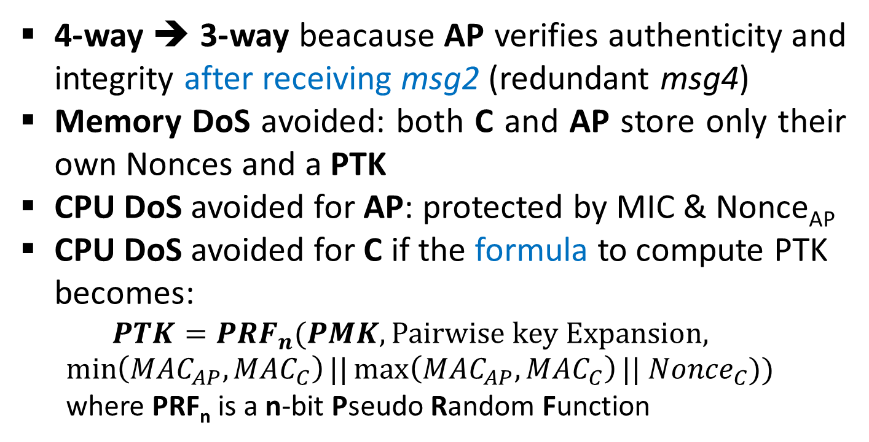
IEEE 802.11i security steps (4/5) – security (cont.)
Network Discovery
IEEE 802.11 Authentication & Association
IEEE 802.1x Authentication
4-Way/Group Key Handshake
---
Observations on SOLUTION D (3-way handshake)
4-way ➔ 3-way beacause AP verifies authenticity and integrity after receiving msg2 (redundant msg4)
Memory DoS avoided: both C and AP store only their own Nonces and a PTK
CPU DoS avoided for AP: protected by MIC & Nonce_{AP}
CPU DoS avoided for C if the formula to compute PTK becomes:
$$PTK={PRF}_{n}(PMK,\text{Pairwise} \text{key} \text{Expansion},$$
$$\min\left({MAC}_{AP}, {MAC}_{C}\right)||\max\left({MAC}_{AP}, {MAC}_{C}\right)|{| Nonce}_{C}))$$
where PRF_{n} is a n-bit Pseudo Random Function
➔ C can computes PTK in advance

Slide 22
4-Way Handshake with GTK (Group Transient Key)
IEEE 802.11i security steps (4/5) – cont.
Network Discovery
IEEE 802.11 Authentication & Association
IEEE 802.1x Authentication
4-Way/Group Key Handshake
---
C
AP
PMK
PMK
Compute
Nonce_{AP}
Compute
Nonce_{C}
& PTK,
store PTK
Msg1 = { MAC_{AP} + Nonce_{AP} + SN }
Msg2 = { MAC_{c} + Nonce_{c} + SN + MIC_{PTK}(Nonce_{c} , SN) }
Compute
& store PTK
& GTK (if 1°),
verify MIC
Verify MIC
&
Install PTK
& GTK
Msg3 = { MAC_{AP} + Nonce_{AP} + SN+1 + encr_{PTK}(GTK) +
MIC_{PTK}(Nonce_{AP} , SN+1, encr_{PTK}(GTK)) }
("Ready to use" )
Verify MIC
&
Install PTK
& GTK (if 1°)
Msg4 = { MAC_{AP} + Nonce_{AP} + SN+1 + MIC_{PTK}(Nonce_{AP} , SN+1) }
("OK, use" )

Slide 23
IEEE 802.11i security steps (5/5)
Network Discovery
Secure Data Communication
4-Way/Group Key Handshake
IEEE 802.1x Authentication
IEEE 802.11 Authentication & Association
Once installed "fresh" PTK and GTK a secure channel of data communication over connected WLAN is established:
C can use PTK to encrypt unicast data frames
C can use GTK to encrypt multicast/broadcast data frames
➔ passive/active eavesdropping, modification etc. are no longer threats for transmitted data

Slide 24
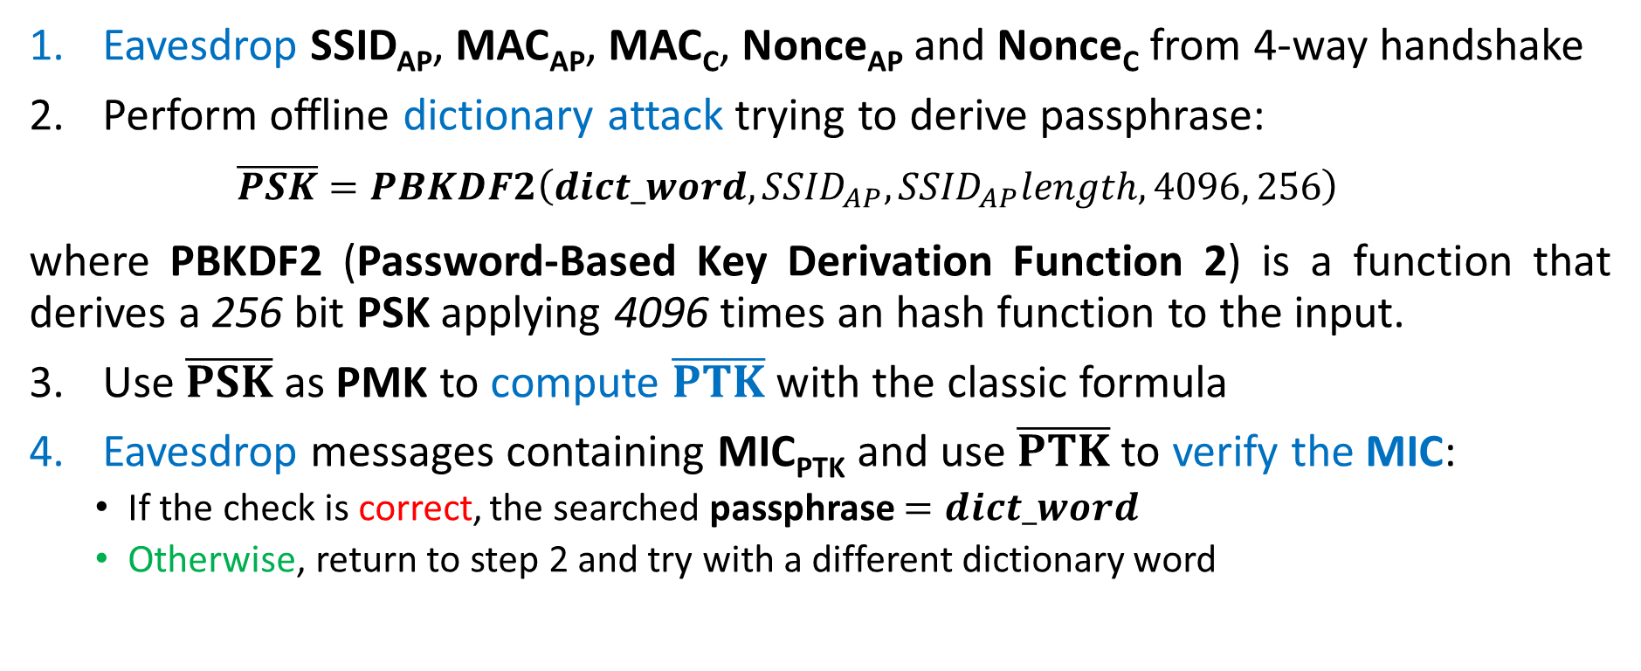
PSK-based authentication vulnerabilities
Offline dictionary attacks for passphrases:
Eavesdrop SSID_{AP}, MAC_{AP}, MAC_{C}, Nonce_{AP} and Nonce_{C} from 4-way handshake
Perform offline dictionary attack trying to derive passphrase:
$$\overline{PSK}=PBKDF2\left(dict_word,{SSID}_{AP}, {SSID}_{AP}length,4096, 256\right)$$
where PBKDF2 (Password-Based Key Derivation Function 2) is a function that derives a 256 bit PSK applying 4096 times an hash function to the input.
Use $\overline{PSK}$ as PMK to compute $\overline{PTK}$with the classic formula
Eavesdrop messages containing MIC_{PTK} and use $\overline{PTK}$ to verify the MIC:
If the check is correct, the searched passphrase $=dict_word$
Otherwise, return to step 2 and try with a different dictionary word
the attack can be mounted for passphrase of length <= 20
(8-63 admitted in WPA2-PSK) and that no contains special characters

Slide 25
PSK-based authentication vulnerabilities - cont.
Man-in-the-Middle attacks for WLAN passive traffic monitoring:
From the internal or after a successful offline-dictionary attack, an adversary get not only the passphrase, but also PTK:
the correct passphrase give us the correct WLAN’s PSK (apply PBKDF2)
In PSK-based authentication, PSK is used as PMK during the 4-way handshake
PTK can be easily derived from PSK (PMK) using the classic formula
since PSK is unique over the same WPA-Personal WLAN, obtaining PTK for an user means obtaining PTKs of all users of WLAN only looking for their nonces!
➔ All the traffic of the clients connected to WLAN can be passively monitored by an adversary without traces

Slide 26
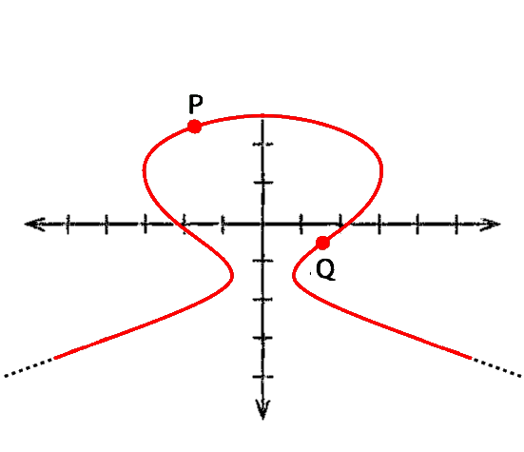
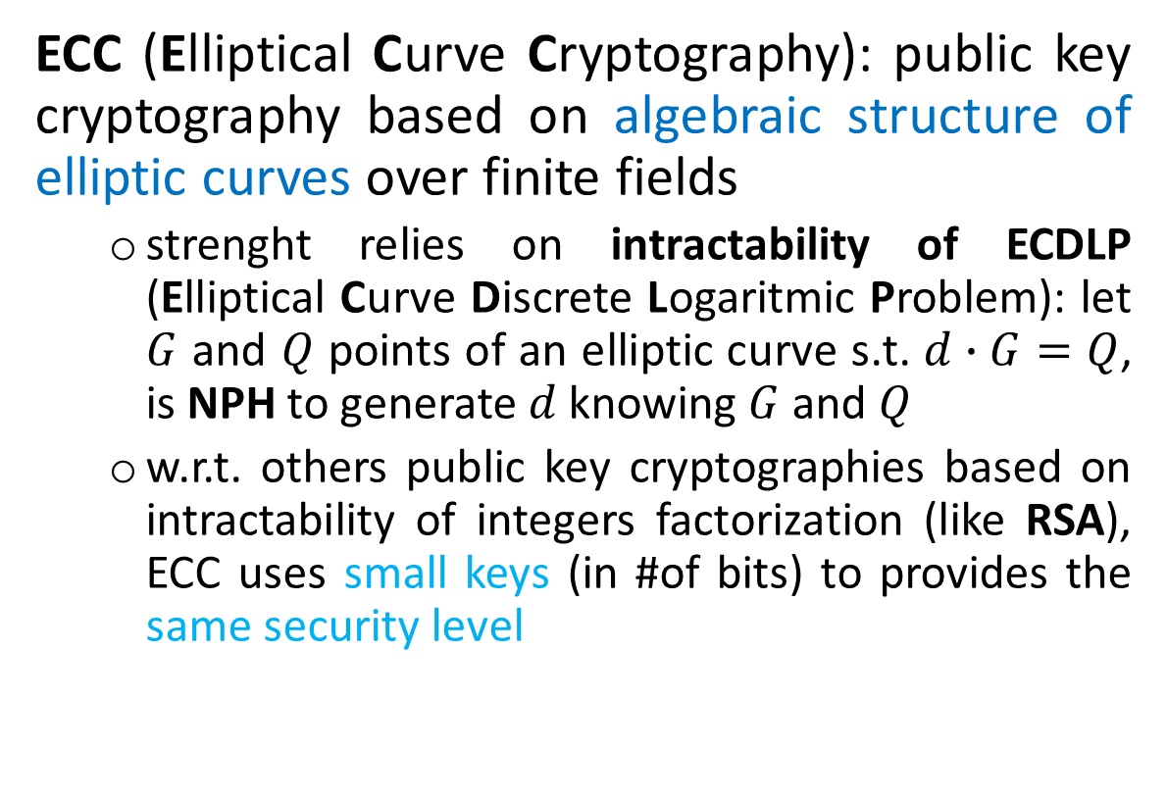
PSK-based authentication vulnerabilities: solutions
To prevent offline-dictionary and MiM attacks, PSK cannot be used directly as PMK ➔ use of ECC-based ECDH protocol + PSK to derive PMK
ECC (Elliptical Curve Cryptography): public key cryptography based on algebraic structure of elliptic curves over finite fields
strenght relies on intractability of ECDLP (Elliptical Curve Discrete Logaritmic Problem): let $G$ and $Q$ points of an elliptic curve s.t. $d∙G=Q$, is NPH to generate $d$ knowing $G$ and $Q$
w.r.t. others public key cryptographies based on intractability of integers factorization (like RSA), ECC uses small keys (in #of bits) to provides the same security level
Cypher Alg. | Key-length | RSA-keysize | ECC- keysize
3DES | 112 | 2048 | 224
AES | 128 | 3072 | 256
AES | 192 | 7680 | 384
e.g. to protect 128-bit AES keys, recc. key-size is:
3072 bits, if use RSA (exp. Increases)
256 bits, if use ECC (lin. increases)

Slide 27
PSK-based authentication vulnerabilities: solutions
To prevent offline-dictionary and MiM attacks, PSK cannot be used directly as PMK ➔ use of ECC-based ECDH protocol + PSK to derive PMK
ECDH (Elliptical Curve Diffie-Hellman) protocol: key-exchange protocol that uses ECC for keys derivation
AP
p = ellipse field
a,b = curve coefficients
G = curve base-point
h: G’s cofactor
n: G’s order
d_{C} , d_{AP} secret keys
d_{AP} G, d_{C} G, public keys
C
(p, a, b, G, n, h)
Choose d_{AP} & compute d_{AP} G
Choose d_{C},
compute d_{C} G &
TPMK = d_{C} d_{AP} G
& hash
PSK
⊕
d_{AP} G
PSK
⊕
d_{AP} G, PSK
⊕
d_{C} G,
Verify hash
& assign
PMK = d_{C} d_{AP} G
H(d_{C} d_{AP} G
, PSK
⊕
d_{AP} G, PSK
⊕
d_{C} G)
PSK
⊕
d_{AP} G,
H(d_{C} d_{AP} G
, PSK
⊕
d_{AP} G)
Verify hash &
install
PMK = d_{C} d_{AP} G
Verify hash &
Install PMK
Then perform handshake
PSK
⊕
d_{C} G,
H(d_{C} d_{AP} G
, PSK
⊕
d_{C} G)

Slide 28
Security of ECDH + PSK
Offline-dictionary attacks avoided:
External adversary doesn’t known PSK ➔ unable to read encrypted traffic
Internal adversary known PSK, so it can sniff and decrypt traffic, but there’s no way to know secret keys (d_{C} , d_{AP}) knowing public keys (d_{AP} G, d_{C} G) thanks to the intractability of ECDLP
MiM attacks partially avoided:
External adversary doesn’t known PSK ➔ unable to read encrypted traffic
Internal adversary known PSK, so it can forge messages like PSK ⊕ d_{MiM} G
➔ Internal MiM attacks for ECDH are still an unresolved issue

Slide 29
Conclusions
Crucial 802.11i vulnerabilities are in 4-way handshake and in PSK-mode
valid solutions for 4-way hanshake are:
check msg1 authenticity and integrity using MIC and PMK
reuse the client-nonce
use the 3-way handshake instead of the 4-way handshake
valid solutions in PSK-mode are:
use "strong" passwords (length >= 20 and containing special characters)
use ECC-based ECDH protocol to generate PMK, combined with PSK to encrypt the traffic

